Slide 1

Prayer
Basics
Understanding the Who, What, When, Where, Why, and How of Prayer

Slide 2
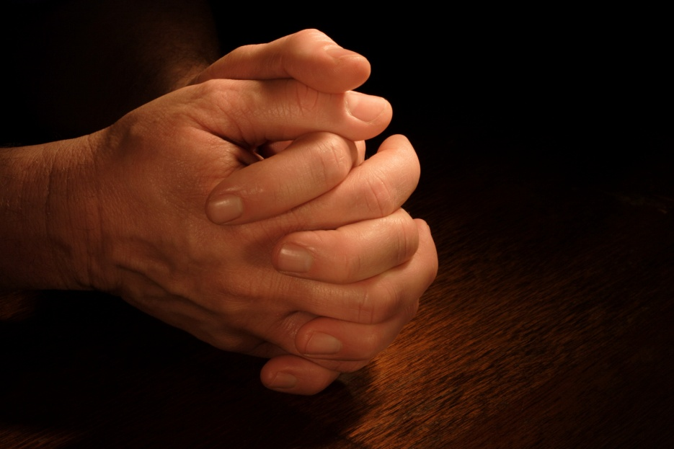
Study 1
Prayer: What’s It
All About?

Slide 3
Prayer Is About
Communication

Slide 4
Our Communication Model:
Message Sent
Message Received
t u

Slide 5
But then, how do we know God has actually heard our prayer???

Slide 6
God’s
Communication Model:
Ongoing, Intimate Communion with Him

Slide 7
“The closer our ______________ with God is, the clearer our ________________ with Him will be.”
relationship
communication

Slide 8
Reflection Question…
Can you relate to the feeling that prayer sometimes seems one-sided, and you wonder if God hears you? Explain.

Slide 9
Reflection Question…
How would your prayer life change if you could always know for certain God is listening?

Slide 10
Reflection Question…
Describe a time when you have clearly sensed the Spirit of God connecting with your inner spirit.

Slide 11
Reflection Question…
What are some things that might keep you from hearing God’s “signal”?

Slide 12
Prayer Is About
Relationship

Slide 13
Challenged By the “Stuff” of Life…

Slide 14
The stuff of life can crowd out not only spending time in ___________ ________ , but ____________ about God at all. And when the stuff of life becomes the ___________ of life, there is little time for anything else.
devotional prayer
thinking
substance

Slide 15
Practicing God’s Presence…

Slide 16
While we cannot spend every waking moment in prayer, we can
be in __________
____________ with Him through the day.
continual
communion

Slide 17
When we learn to practice God’s presence, three things are accomplished:
* We gain victory in the
battleground of our minds.
* We become attuned to the
voice of the Holy Spirit.
* We become effective witnesses
in the world around us.

Slide 18
Reflection Question…
Where does intentional time with God and His Word fit into your calendar?

Slide 19
Reflection Question…
What is some “stuff” that you could eliminate or bypass that would allow more time for you to spend with God?

Slide 20
Reflection Question…
How does taking a few moments to express praise and adoration to God make a difference in your day?

Slide 21
Reflection Question…
What are some steps you can take to help make spirituality flow through your
day-to-day life?

Slide 22
Prayer Is About
Alignment

Slide 23
Aligned with God’s Righteousness

Slide 24
As we _________ God’s presence we become aligned with His ___________ , which is righteous and holy.
practice
character

Slide 25
Right _________ with God always is dependent upon ________ ______
from sin.
standing
turning away

Slide 26
Aligned with God’s Truth

Slide 27
As we align our lives with the truth of ________ ________ , He is pleased to _________ to our prayers.
God’s Word
answer

Slide 28
Aligned with God’s Will

Slide 29
Aligning with God’s will takes place when we faithfully pursue:
* Prayer
* Growing in God’s Word
* Practicing God’s Presence

Slide 30
Reflection Question…
Are there areas in your life where you feel you need to align more closely with God’s righteousness?

Slide 31
Reflection Question…
How does prayer affect your Bible reading, and
vice-versa?

Slide 32
Reflection Question…
Think about the prayers you’ve prayed recently. How much have those prayers related to aligning with God’s will versus meeting personal needs or interests?

Slide 33
Reflection Question…
What has been the result as you have endeavored to pray according to God’s will?

Slide 34
“This is the confidence we have in approaching God: that if we ask anything according to his will, he hears us.”
(1 John 5:14, NIV)

Slide 35
Credits
All materials in this presentation have been prepared by and provided from the Assemblies of God National Prayer Center, www.prayer.ag.org.
© 2010 by Gospel Publishing House, 1445 N. Boonville Ave., Springfield, Missouri 65802. All Rights Reserved.
Permission to replicate for personal or church use only.
All scripture quotations, unless otherwise indicated, are taken from the HOLY BIBLE, NEW INTERNATIONAL VERSION®. NIV®. Copyright ©1973, 1978, 1984 by International Bible Society.
Used by permission of Zondervan.
All rights reserved.

